Slide 1
Mr. Coffee
Garage Door Opening System
Jim Gregoire, Alex Johnson, Michael Miller, Will Shiver

Slide 2
Product Description/Overview
Product Vision: A garage door opening system with work light activated by user interaction.
Users and Other Stakeholders: Garage Door developers, users, salesmen
Project Scope: This project includes the software needed to activate a mounted motor for a garage door, a work light, and a remote control.
Constraints: The model does not address issues like security codes or radio signals or obstruction detection.
Notes:
Alex

Slide 3
Functional and Data Requirements
Functional
  Stationary Device
  Remote Device
  Mounted Motor
  Simulation
Data
  Device Interface
  Stationary Control User Interface
Notes:
Jim

Slide 4
Non-Functional Requirements
Installation
Operation
Failure
Notes:
Mike

Slide 5
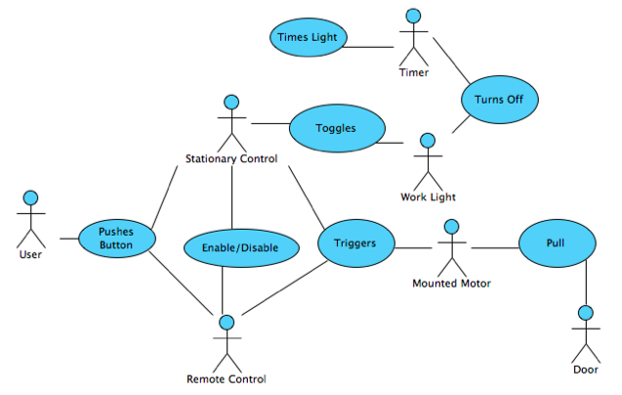
Use Case Diagram
Notes:
Alex

Slide 6
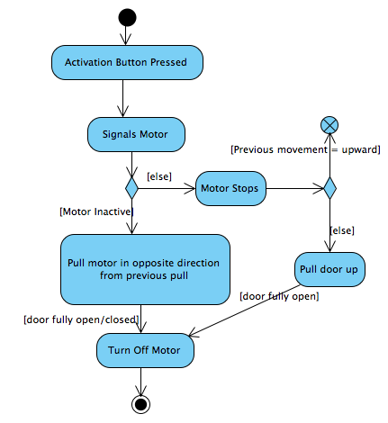
Activity Diagram
only for mounted motor activation
Notes:
Will

Slide 7
Software Architecture Layers
User Interface (Stationary)
User Interface (Remote)
Motor
Device Interface
Simulation

Slide 8
User Interface (Stationary)
Modules
  Activator Button
  Remote Enable/Disable Button
  Work Light Button
Interface Specifications
Design Rationale
Notes:
Will

Slide 9
User Interface (Remote)
Modules
  Activator Button
  Indicator Light
Interface Specifications
  Send signal to indicator light
  Send signal to motor
Design Rationale
Notes:
Alex

Slide 10
Motor
Modules
  Motor
  Motor Interface
Interface Specifications
  Pull door open
  Push door closed
  Stop
  Reverse
Design Rationale
Notes:
Jim

Slide 11
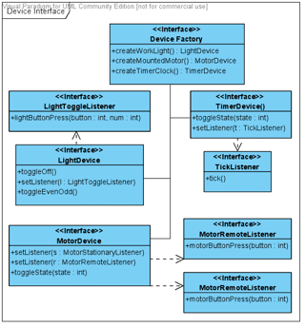
Device Interface
Modules
Interface Specifications
Design Rationale
Notes:
Mike

Slide 12
Simulation Layer
Modules
  Remote Device
  Stationary Device
  Motor
Interface Specification
Design Rationale
Notes:
Jim

Slide 13
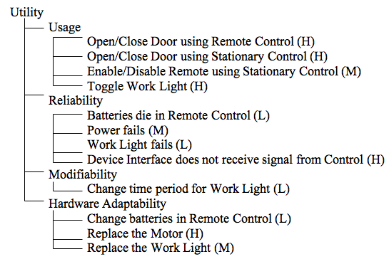
Utility Tree
Notes:
Alex

Slide 14
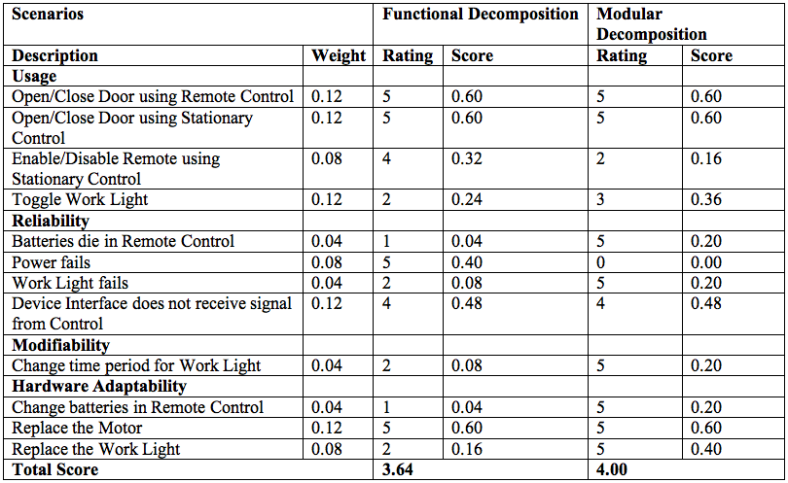
Scenarios
Notes:
Mike

Slide 15
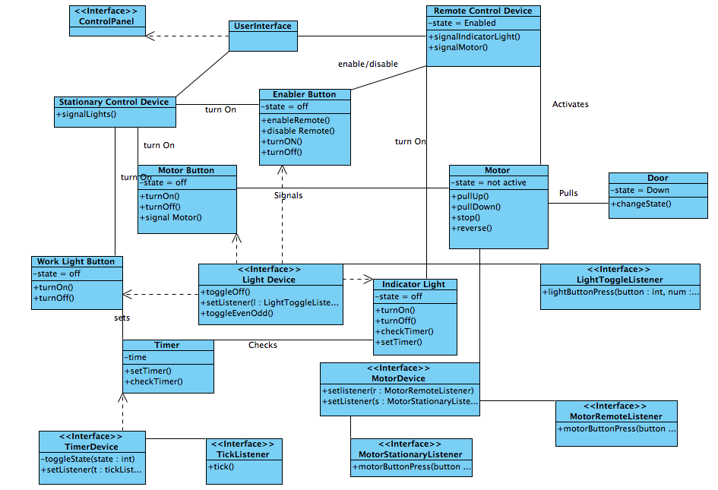
Notes:
Will

Slide 16
Detailed Design - Simulation
Notes:
Alex

Slide 17
Mapping Between Models
Device
  User Interface (Stationary)
  User Interface (Remote)
  Motor
  Device Interface
Simulation
  SimStationary
  SimRemote
  SimMotor
  Simulation
Notes:
Alex

Slide 18
Motor Layer
Device Interface keeps track of the previous direction and whether the motor is currently active
Notes:
Will

Slide 19
User Interface
Notes:
Will

Slide 20
Stationary Control Device
Three buttons
  Motor Activation
  Enable/Disable Remote
  Toggle Work Light
Notes:
Jim

Slide 21
Stationary Control cont.
Notes:
Jim

Slide 22
Device Interface Layer
Notes:
Mike

Slide 23
Design Rationale
Mr. Coffee’s Priority’s
  Safety of client
  Usage/Reliability
Virtual Machine
Notes:
Alex

